Slide 1
Brünlital TEM 2025
Measurements from July 10th, 2025
Jakob Welkens & Peter Balogh

Slide 2
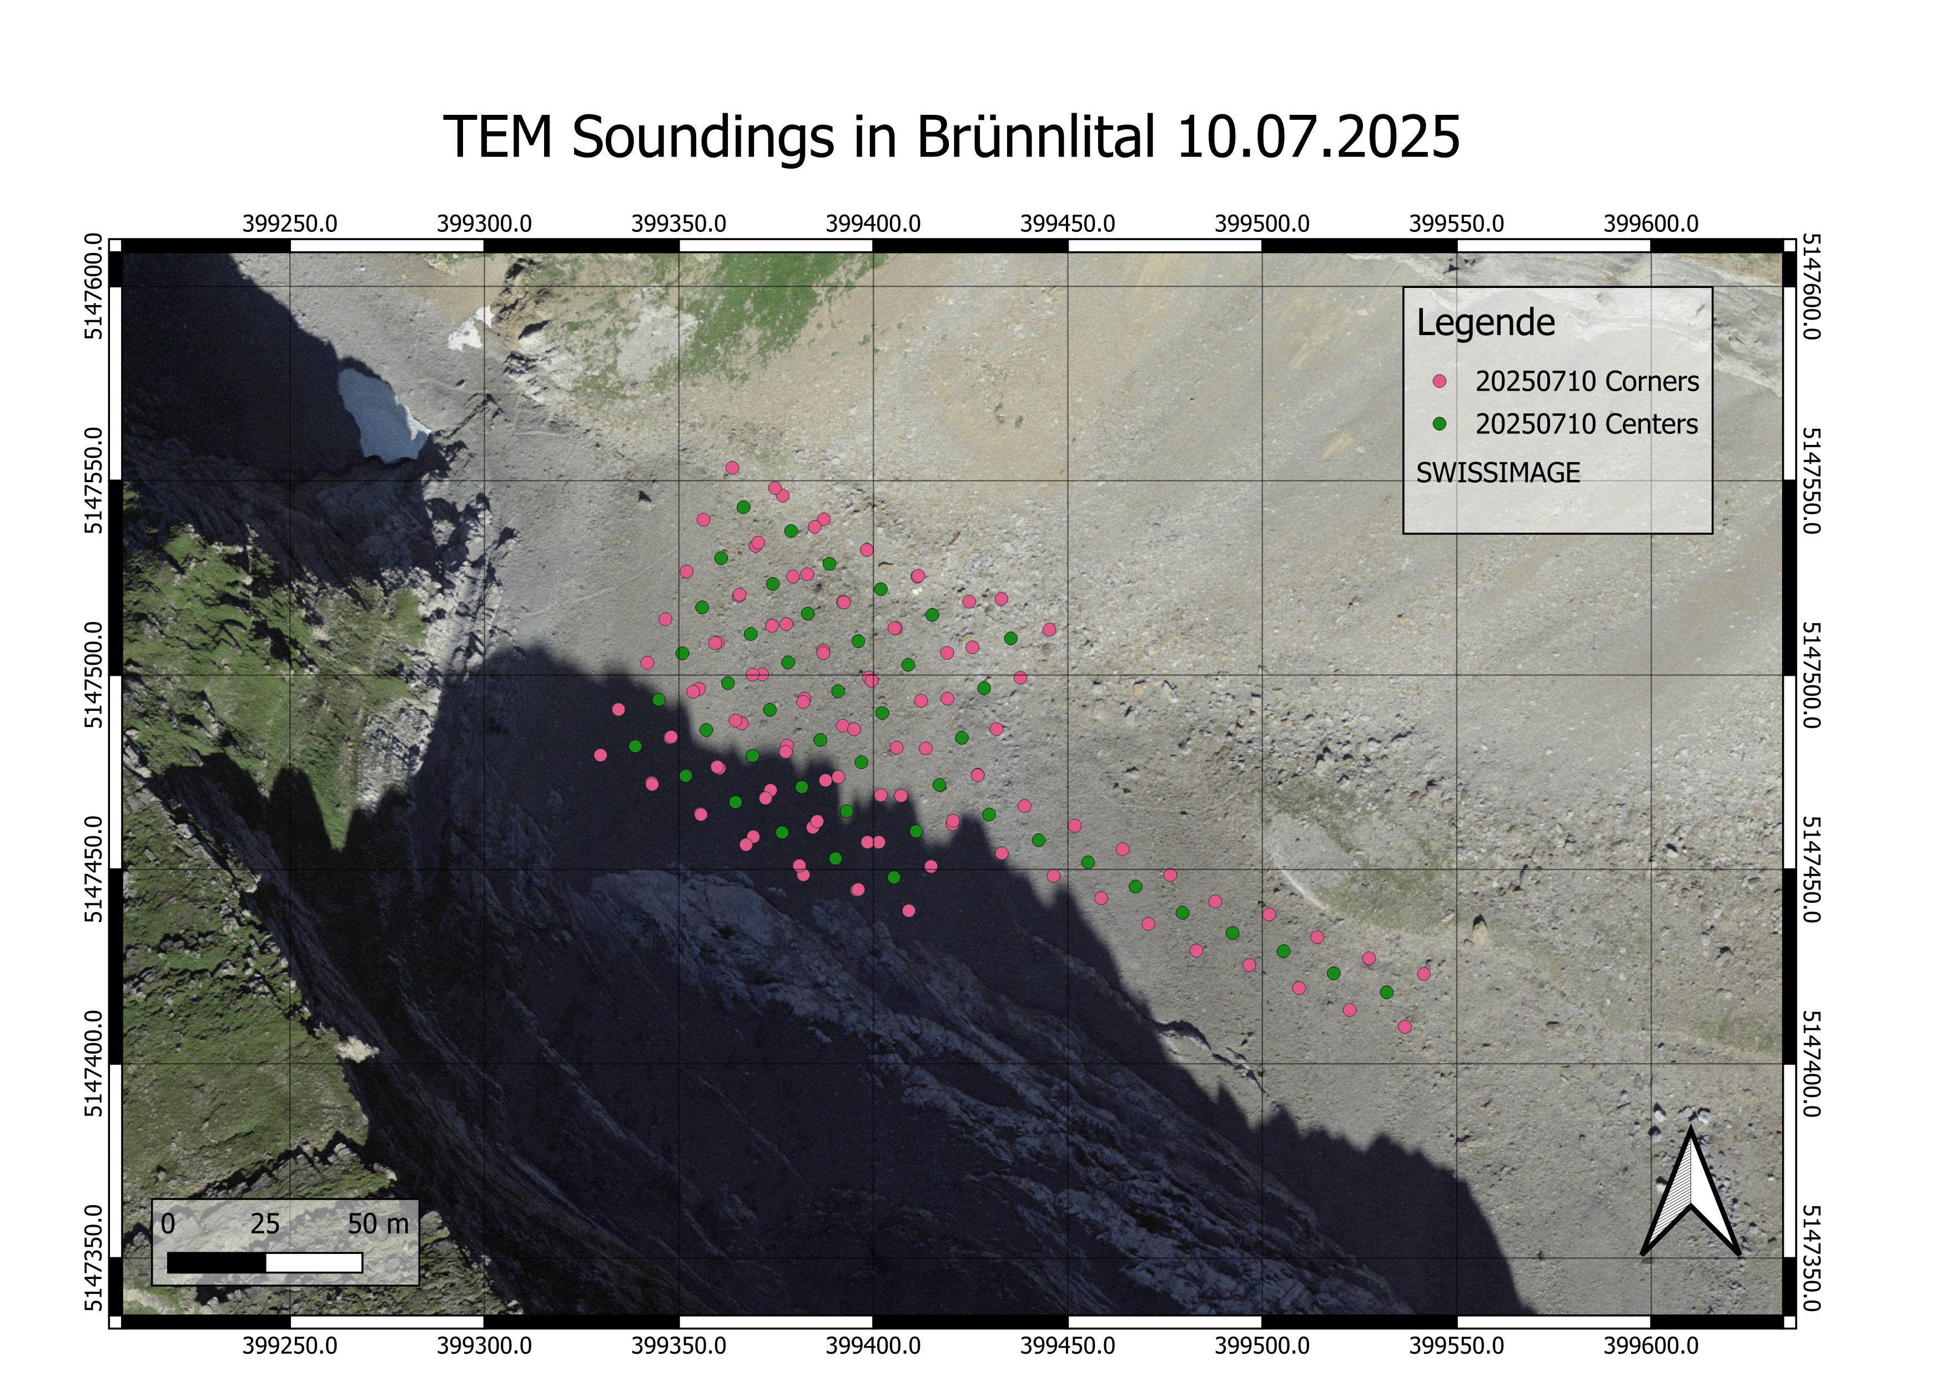
Map of Soundings

Slide 3
Measurement Parameters
All soundings were aquired using the following parameters on July 10th
4A of current
24 V
Timekey 3 (later values with timekey 4 were erroneous)
Stacking paramter 10
15m loop side length

Slide 4
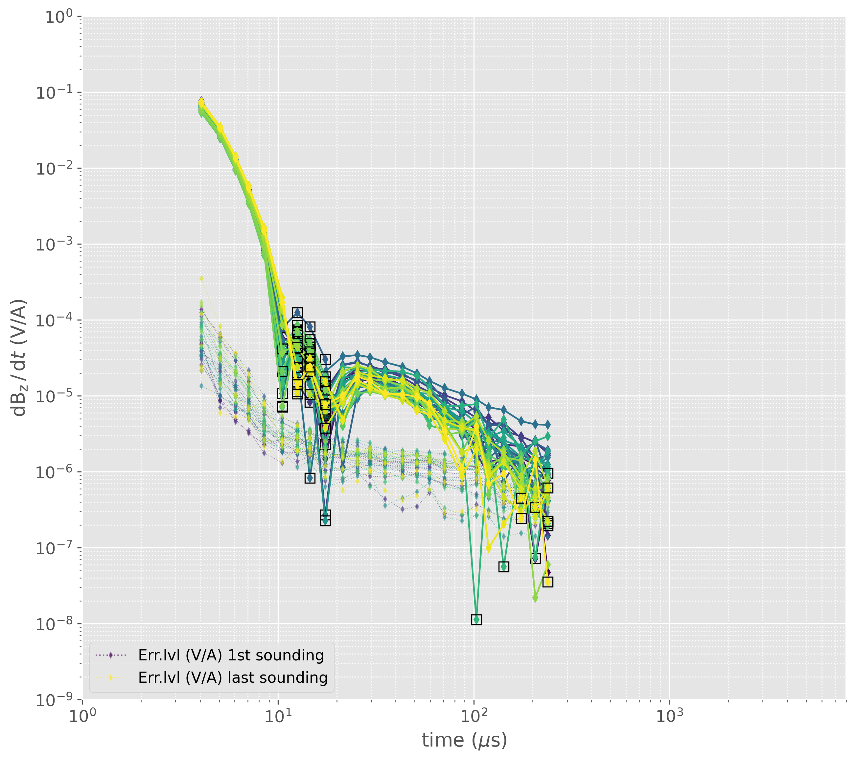
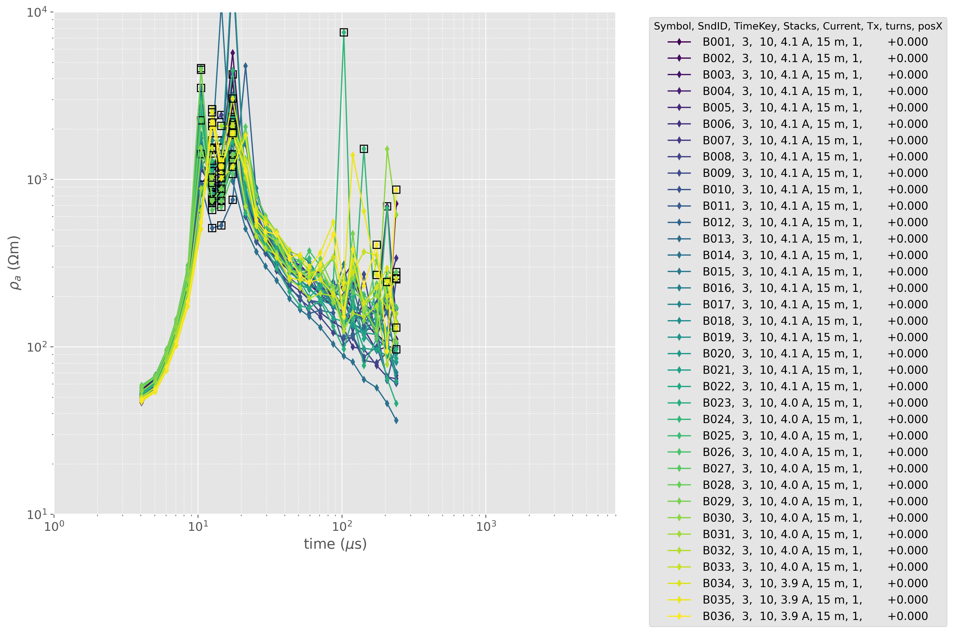
Data Overview – Area Coverage

Slide 5
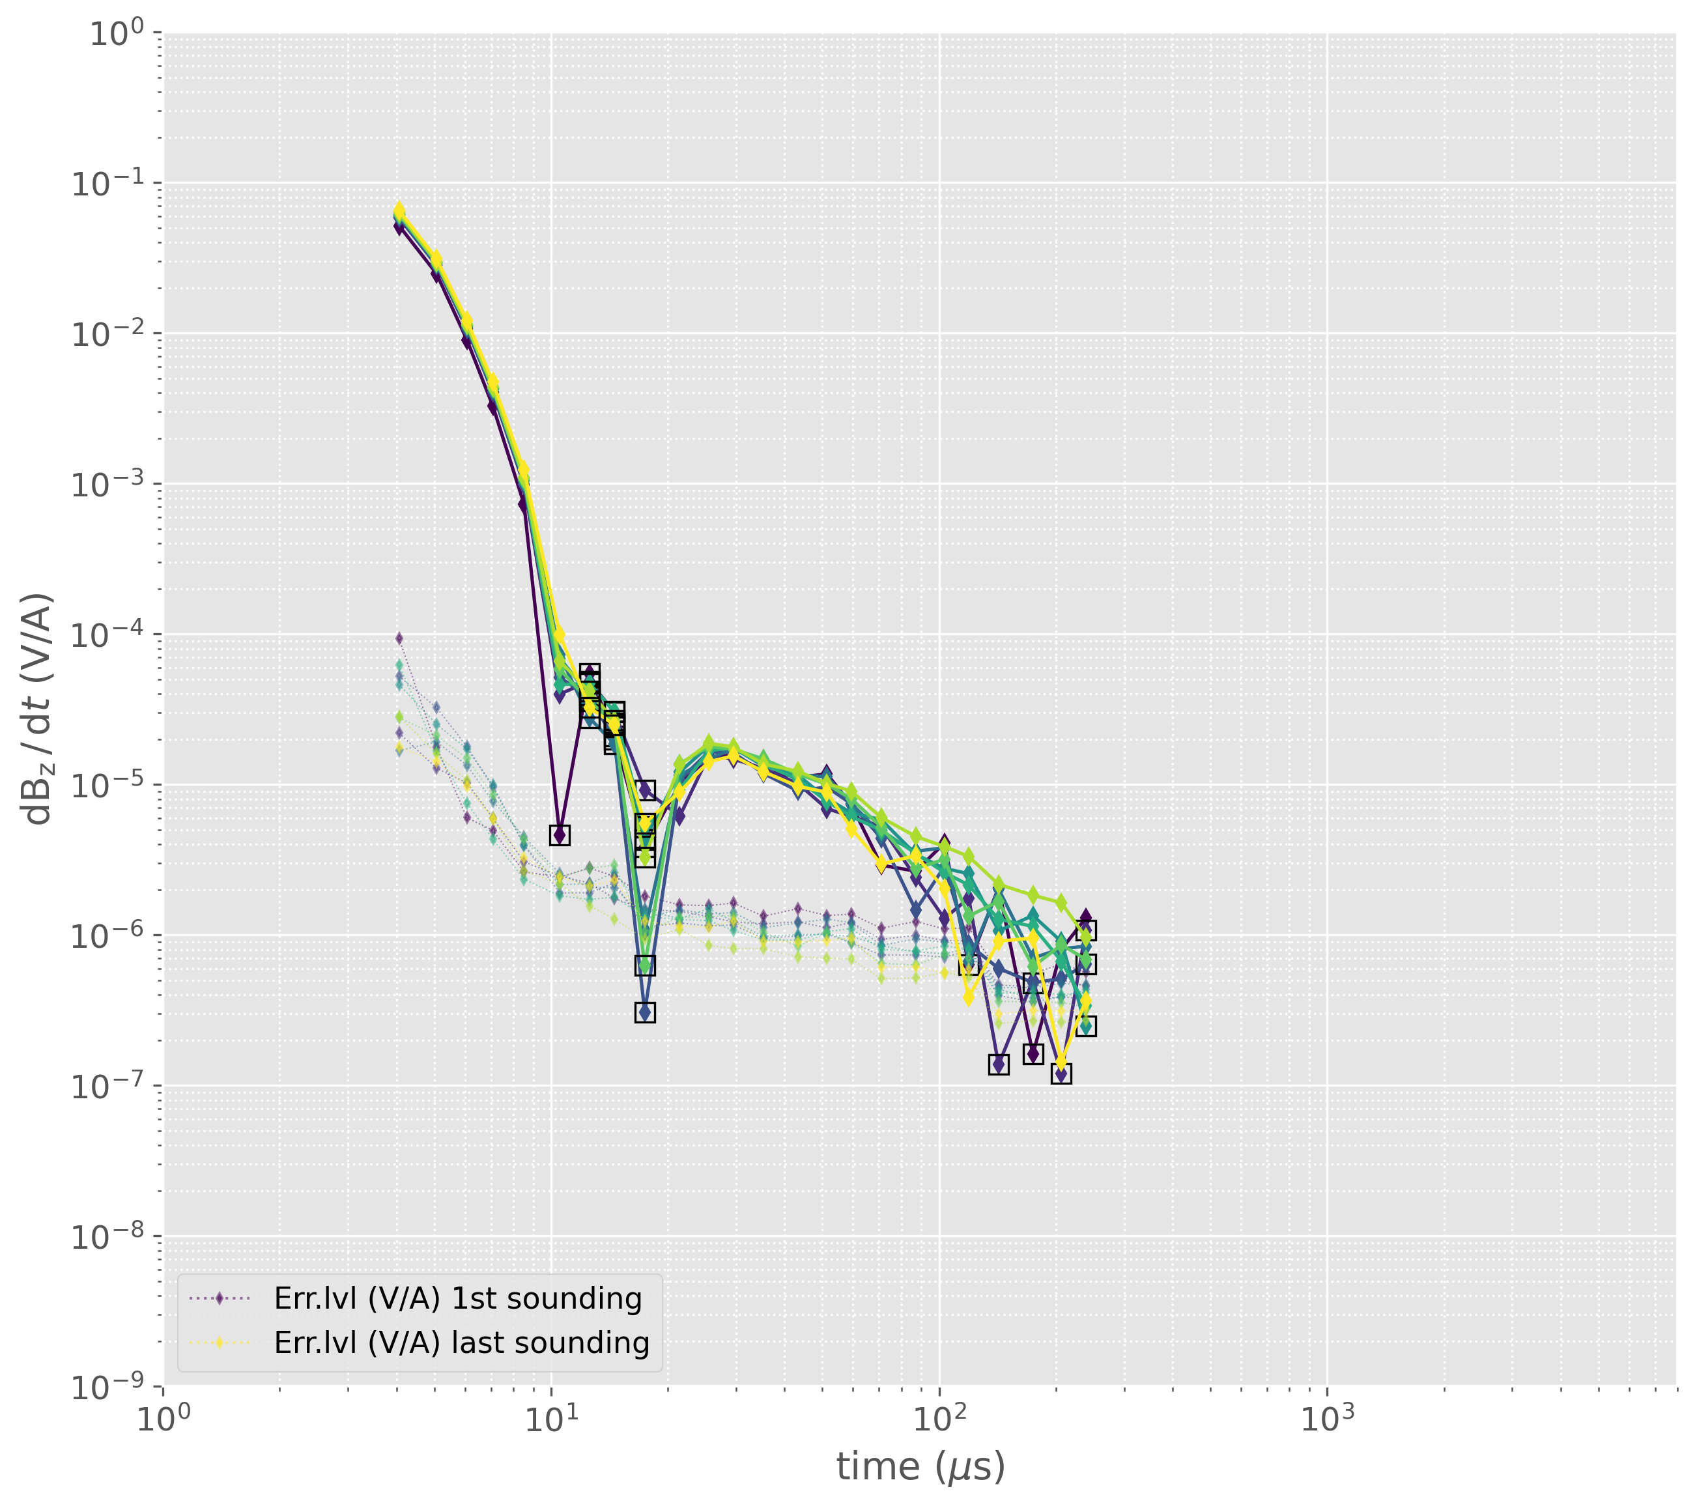
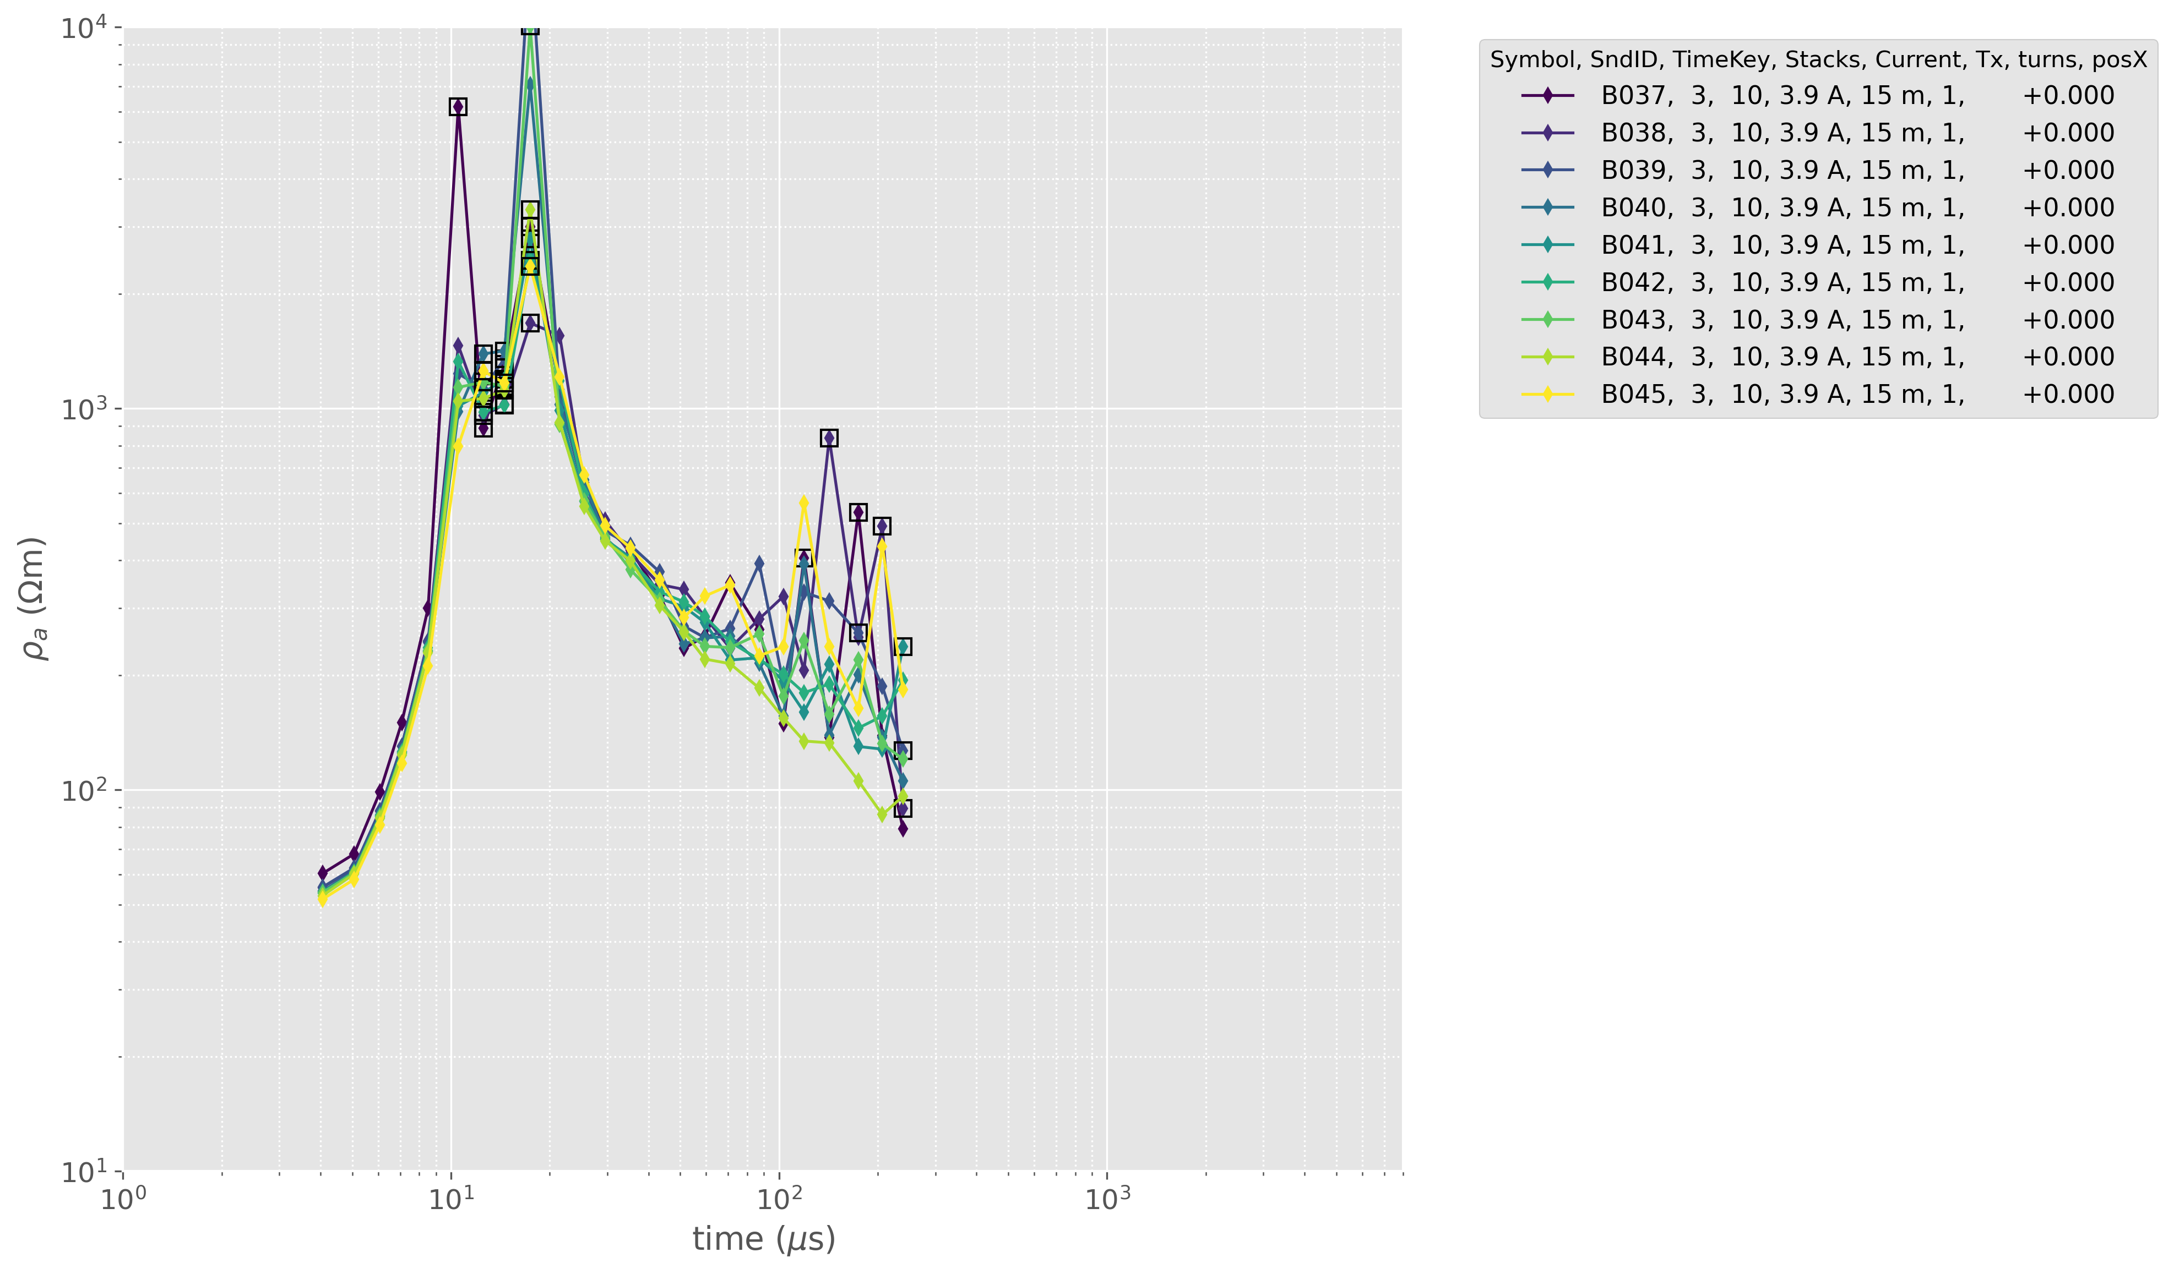
Data Overview – Profile Coverage

Slide 6
Inversion Parameters – Starting Model
3 layer inversion
Filter 5-100μs
thk = [5, 5, 8]
res = [50, 1500, 1500, 500]
mpa = [0.0, 0.4, 0.4, 0.0]
taup = [1e-6, 5e-4, 5e-4, 1e-6]
c = [0.1, 0.7, 0.7, 0.1]
4 layer inversion
Filter 5-100μs
thk = [4, 4, 4, 8]
res = [50, 1500, 1500, 500, 500]
mpa = [0.0, 0.4, 0.4, 0.4, 0.0]
taup = [1e-6, 5e-4, 5e-4, 1e-6, 1e-6]
c = [0.1, 0.7, 0.7, 0.1, 0.1]

Slide 7
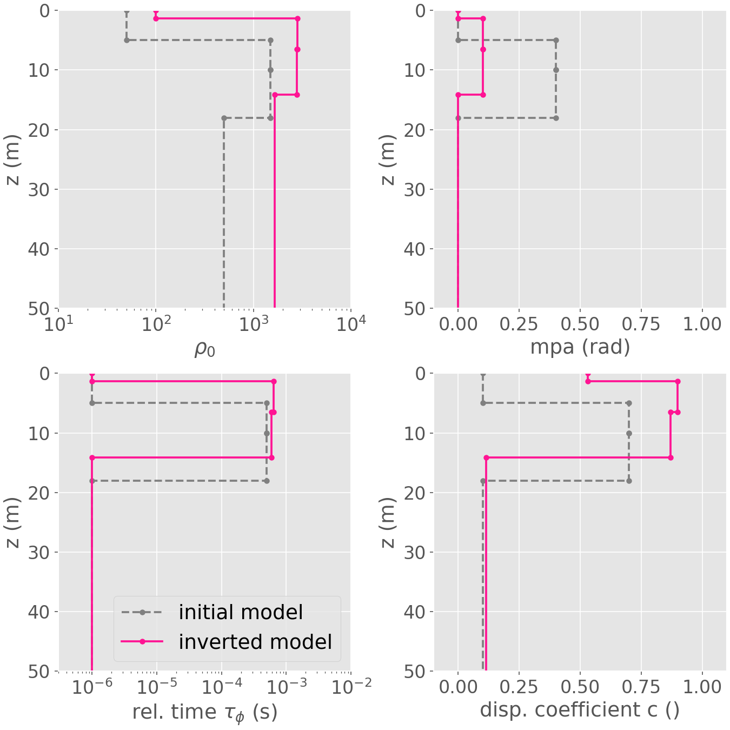
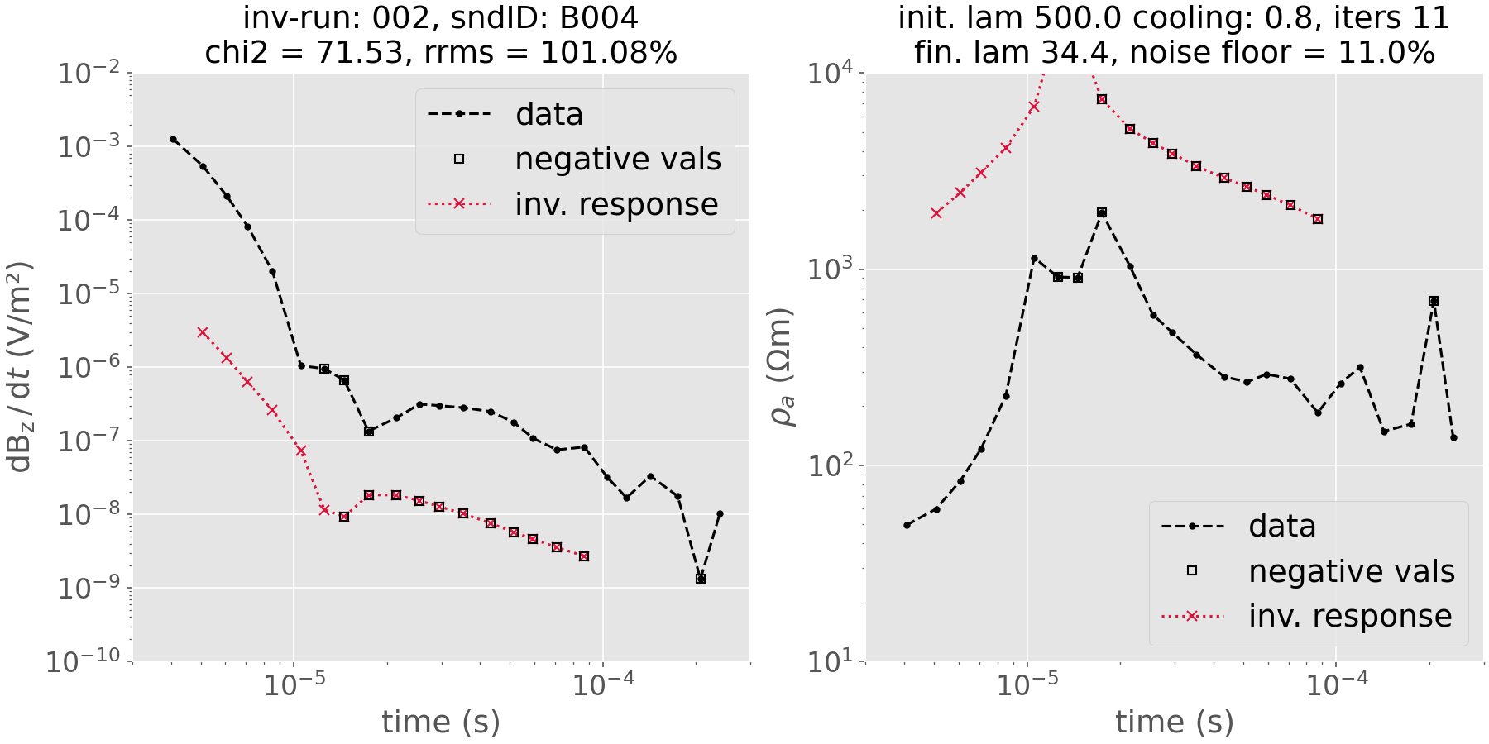
Inversion Parameters – Starting Model
Sounding B004, 3 Layer Model

Slide 8
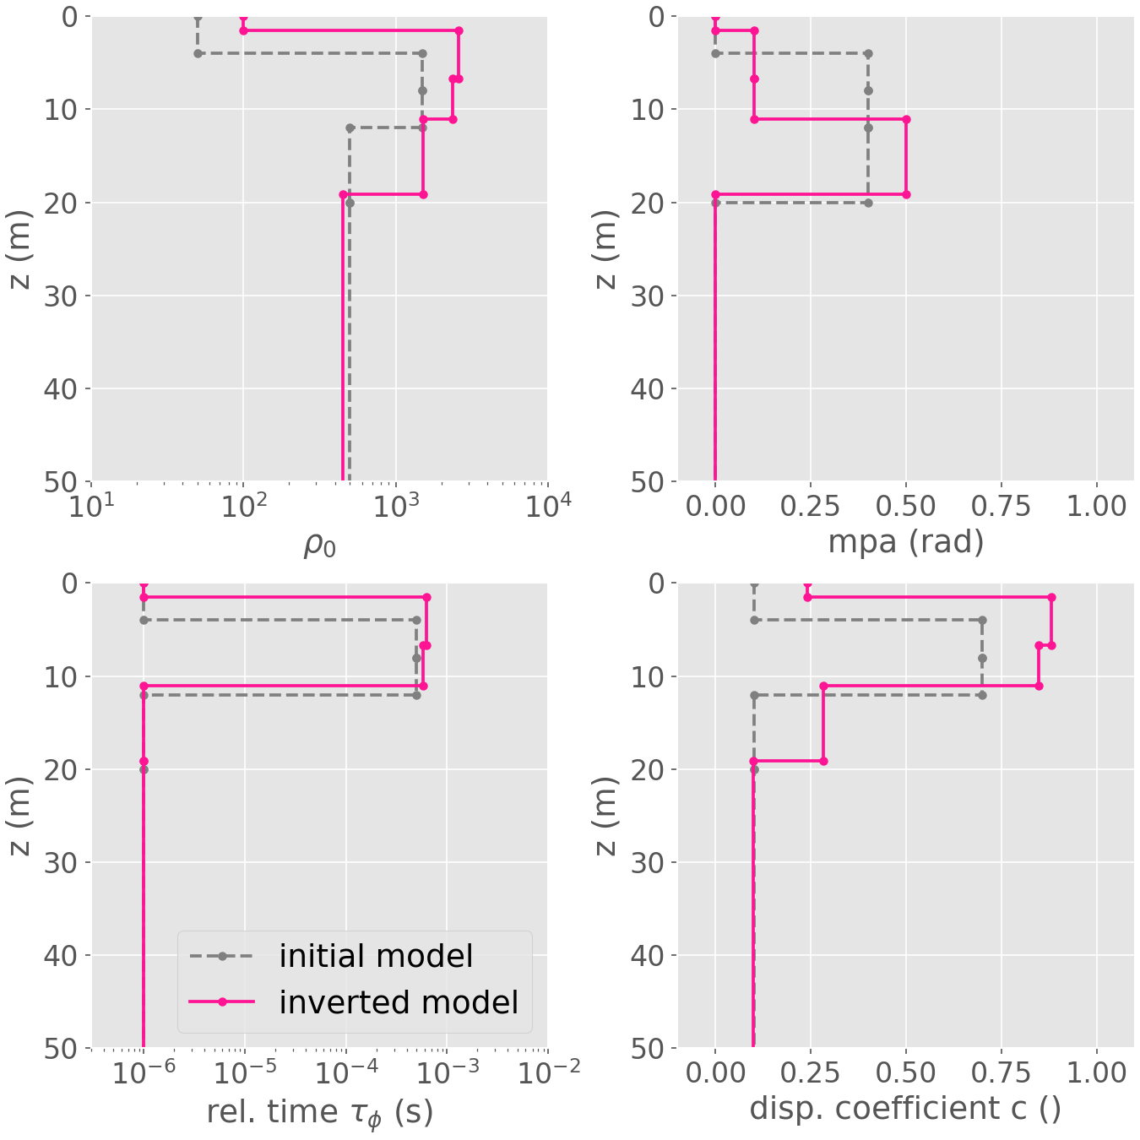
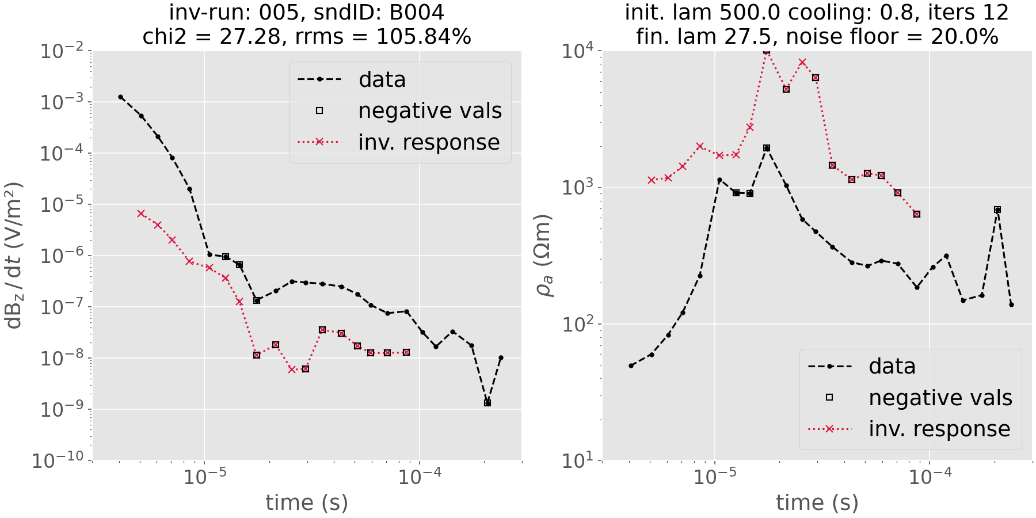
Inversion Parameters – Starting Model
Sounding B004, 4 Layer Model

Slide 9
Interpretation
The IP-layer is visible in all soundings, but not always with the same extent
Using the 4 layer model appears to give more details in the inversion but the rrms and chi2 are always rather high
For sounding B004 (the previous slides) the IP layer probably starts at about 2-3m depth and has a thickness of maybe 10m

Slide 10
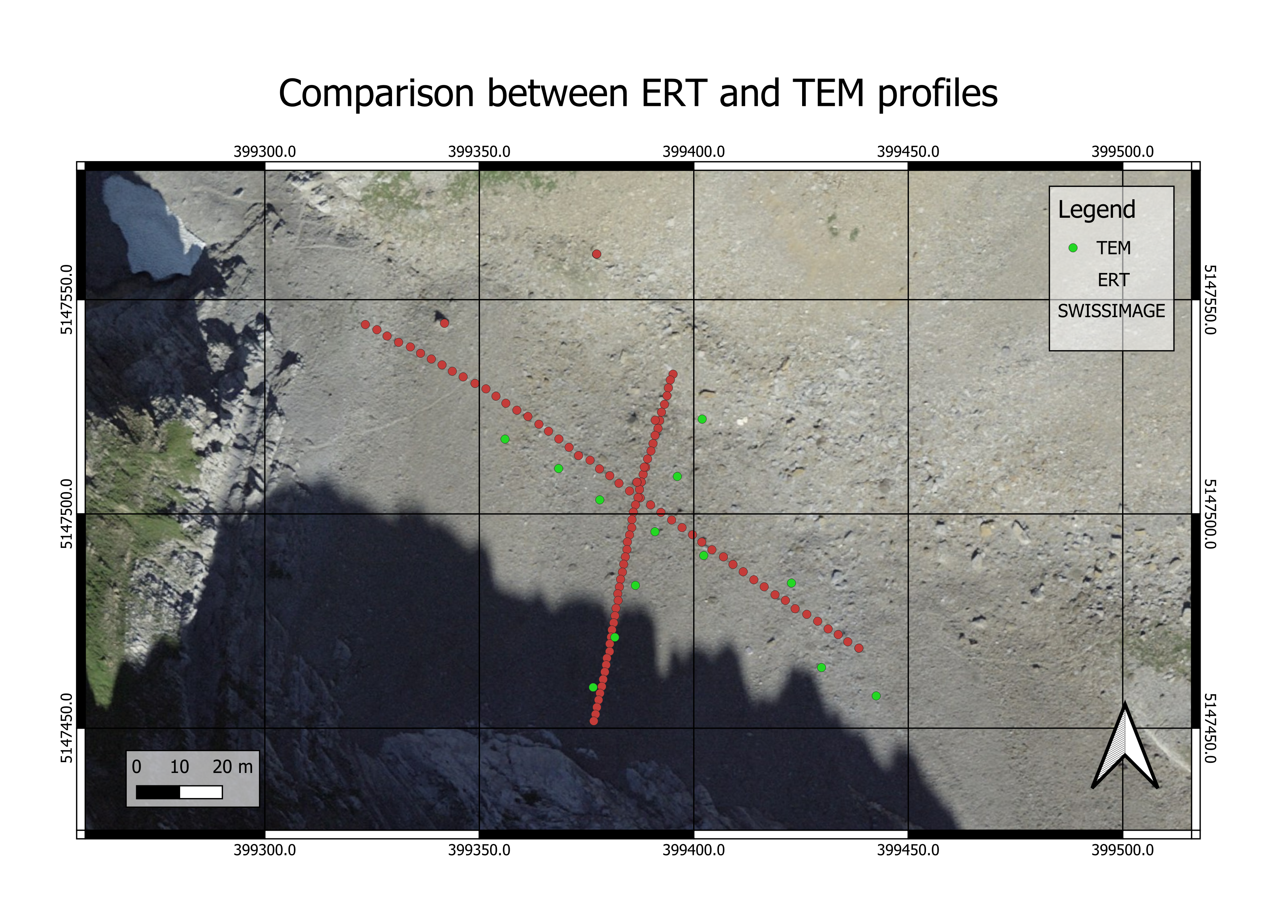
Map of 2D-sections

Slide 11
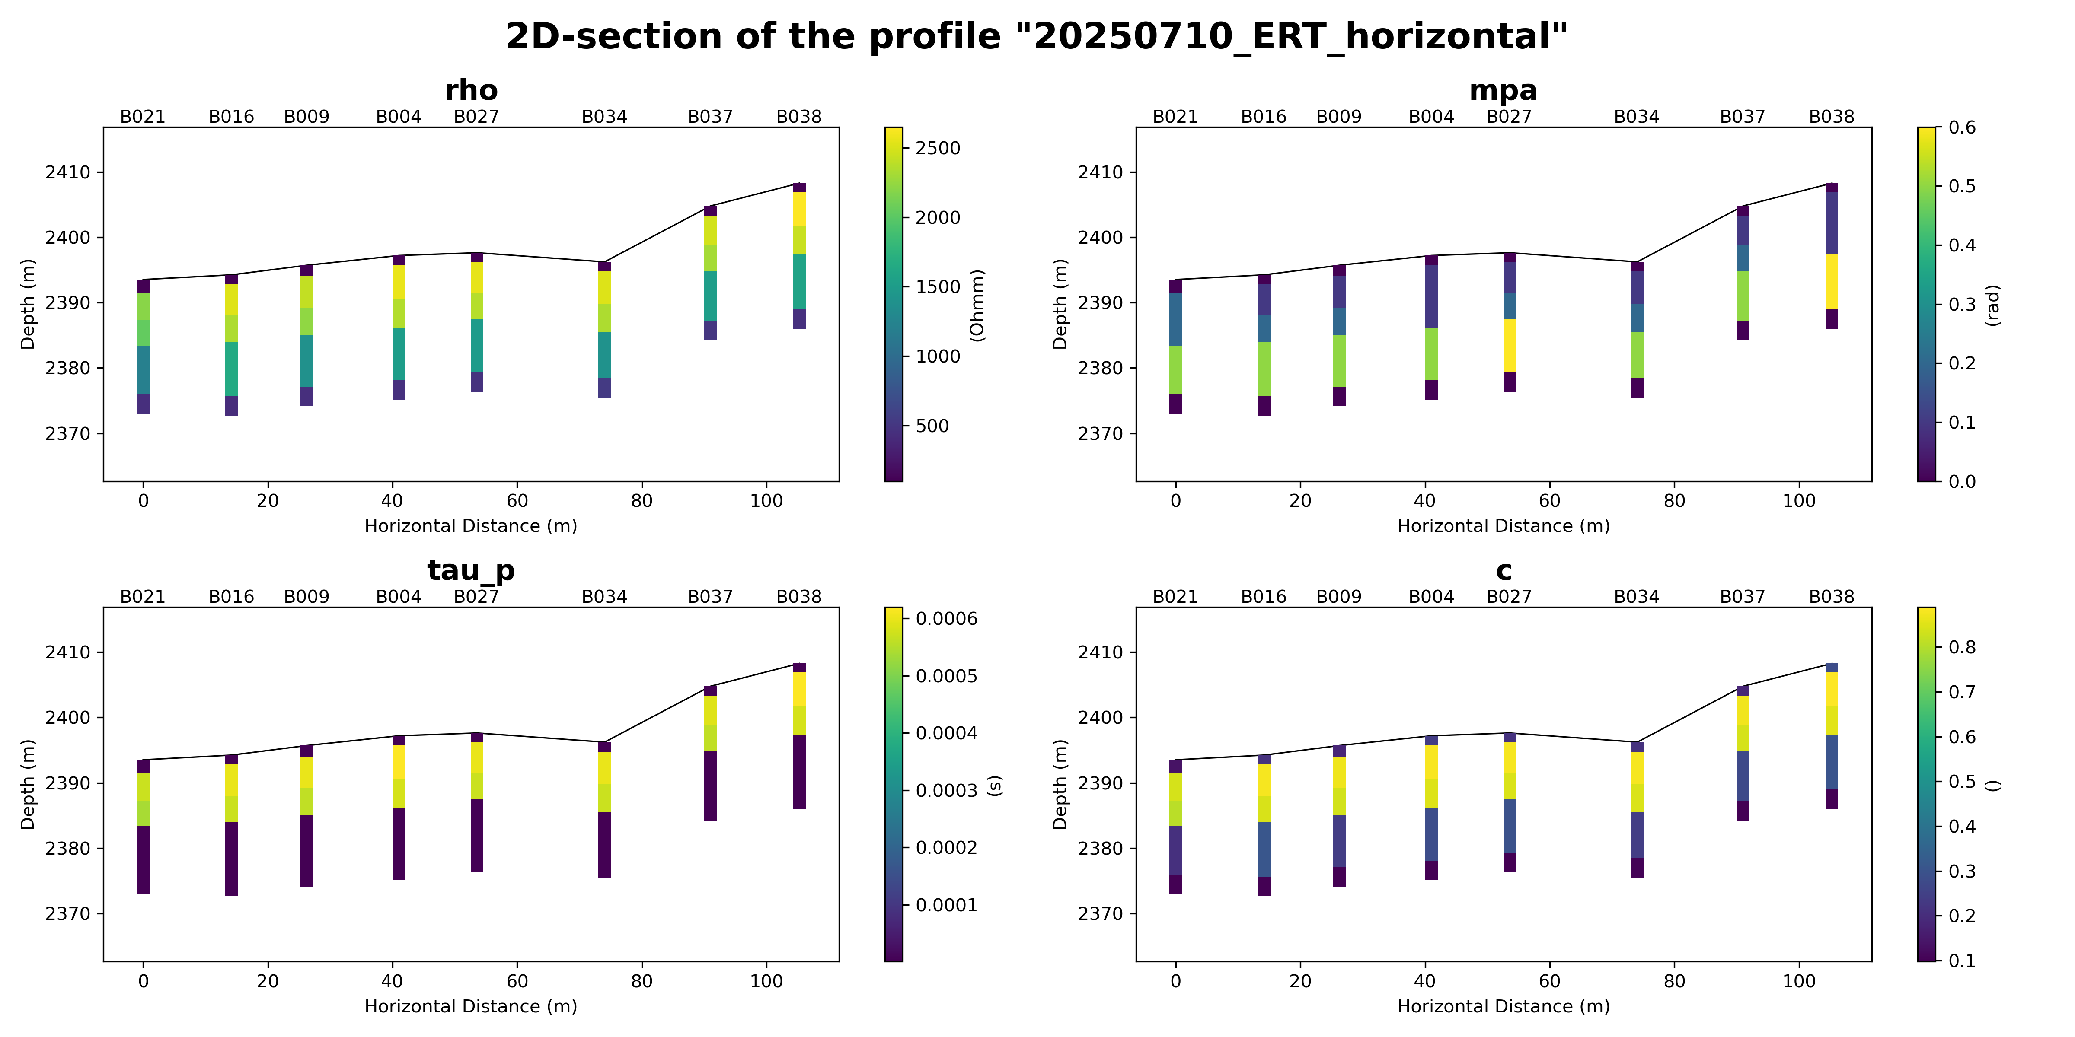
2D-section parallel to valley

Slide 12
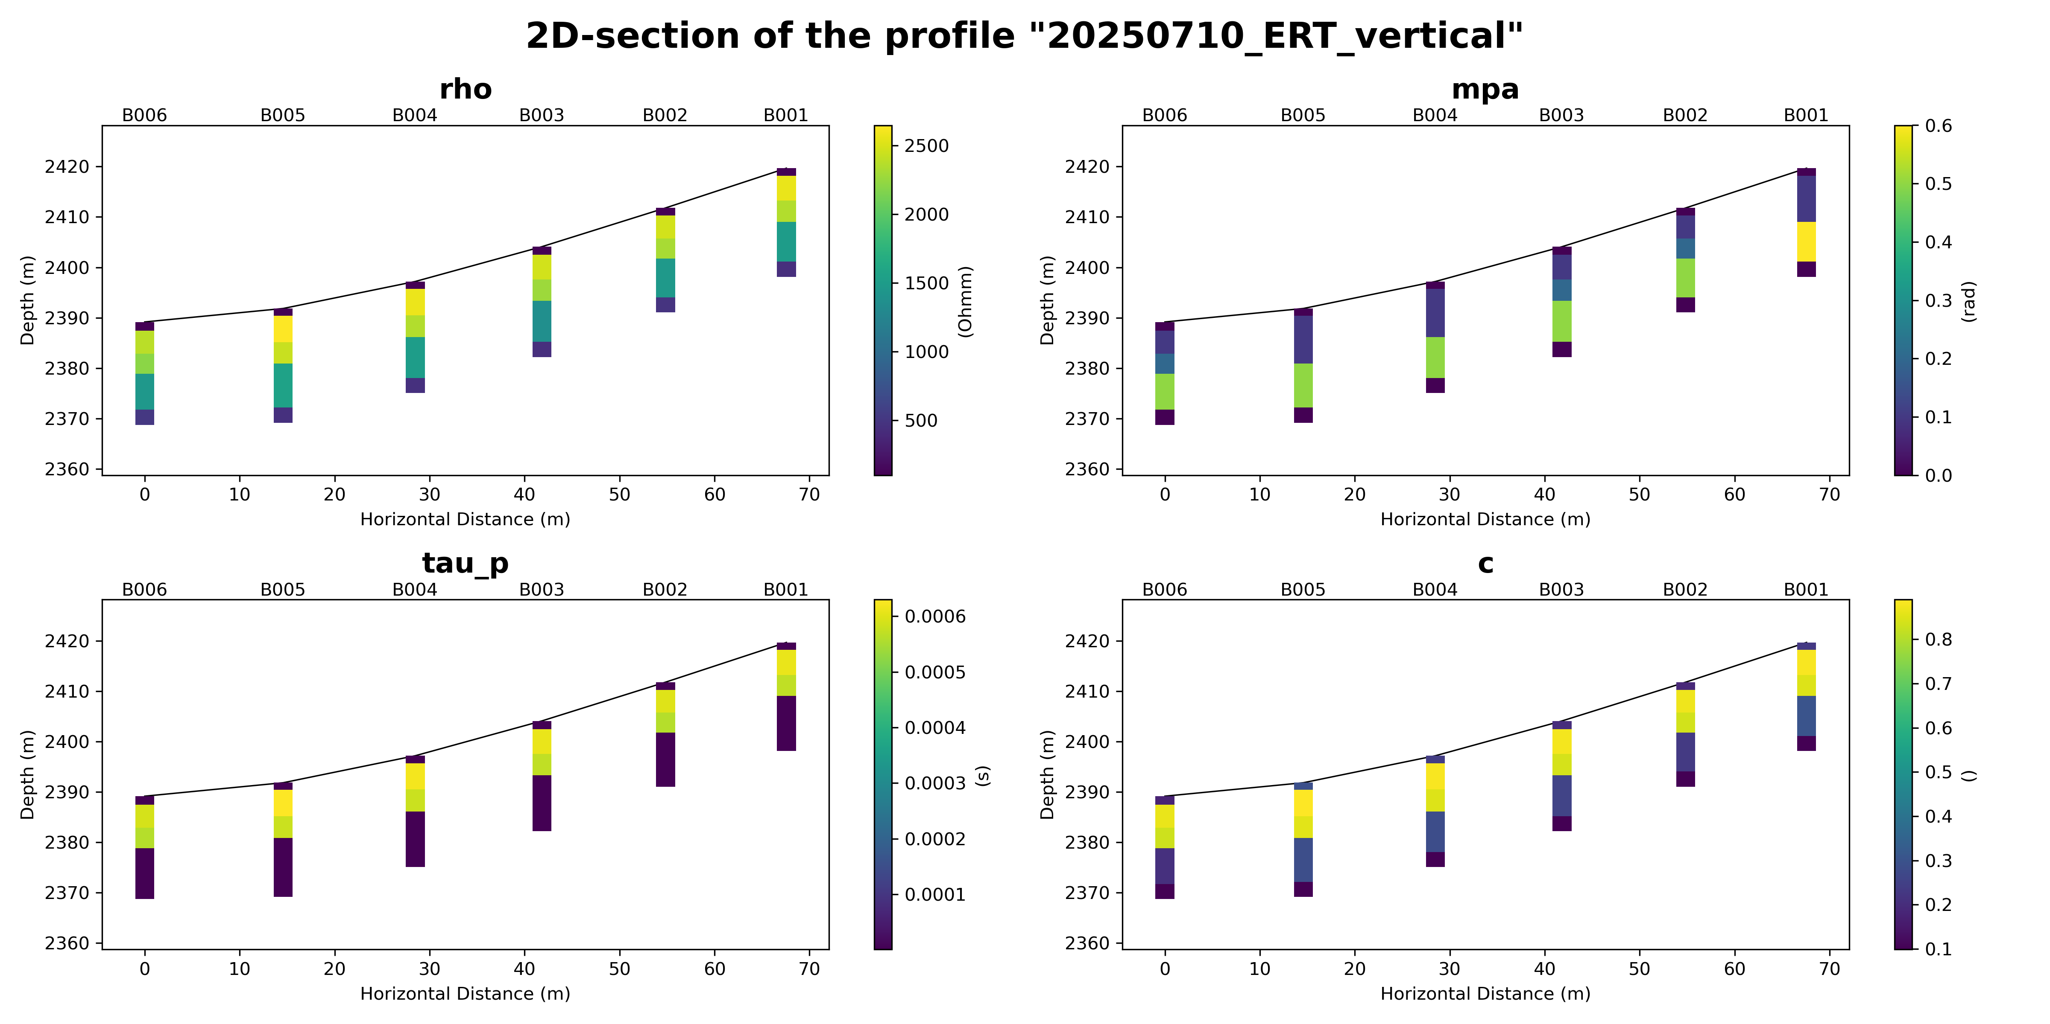
2D-section perpendicular to valley

Slide 13
Further plan – ideas (please comment on them)
2D-sections for all lines horizontal and vertical to grasp the area coverage
Different starting models (happy about suggestions)
Comparison of region with IP-effects with ERT, SRT and SIP data
Comparison with TEM soundings from last year

